Slide 1
Web Engineering
Lecture 2
PROTOCOLS
(TCP/IP, HTTP)
Zulfiqar Ahmad
Lecturer
Department of Information Technology
Hazara University Mansehra
zulfiqarahmad@hu.edu.pk

Slide 2
Sockets
Sockets, or ports, are a very low level software construct that allows computers to talk to one another
When you send information from one computer to another, you send it to a port on the receiving computer
If the computer is “listening” on that port, it receives the information
In order for the computer to “make sense” of the information, it must know what protocol is being used
Common port numbers are 80 (for web pages), 23 (for telnet) and 25 and 110 (for mail)
Port numbers above 1024 are available for other kinds of communication between our programs
Notes:
Telnet: Telecommunication network: a network protocol that allows a user on one computer to log into another computer that is part of the same network
Telnet: log into a remote computer using a telnet program.

Slide 3
Protocols
In order, for computers, to communicate with one another, they must agree on a set of rules for who says what, when they say it, and what format they say it in
The set of rules used by computers for communication is called a protocol.
Some common protocols are HTTP (for web pages), FTP (for file transfer), and SMTP (Simple Mail Transfer Protocol)
Notes:
Protocols may be in ASCII (characters) or in binary

Slide 4
What is a protocol?
A protocol is the set of rules governing a conversation between people
We have seen that the client and server carry on a machine-to-machine conversation
A network protocol is the set of rules governing a conversation between a client and a server
There are many protocols, e.g. TCP/IP, HTTP etc.
Notes:
Follow protocol – follow the rules of the conversation

Slide 5
TCP/IP
The Internet (and most other computer networks) are connected through TCP/IP networks
TCP/IP is actually a combination of two protocols:
IP, Internet Protocol, is used to move packets (chunks) of data from one place to another
Places are specified by IP addresses: four single-byte (0..255) numbers separated by periods
Example: 192.168.1.1
TCP, Transmission Control Protocol, ensures that all necessary packets are present, and puts them together in the correct order
TCP/IP forms a “wrapper” around data of any kind
The data uses its own protocol, for example, FTP
Notes:
TCP/IP: Transmission Control Protocol/Internet Protocol

Slide 6
Hostnames and DNS servers
The “real” name of a computer on the internet is its four-byte IP address
People, however, don’t like to remember numbers, so we use hostnames instead
For example, the hostname www.cis.upenn.edu is 158.130.12.9
A DNS (Domain Name Server) is a computer that translates hostnames into IP addresses
A domain name server (DNS) is a machine that keeps a table of names and corresponding IP addresses
Think of it as like a phone book--names to useful numbers
Of course, you have to know the IP address of the DNS in order to use it!

Slide 7
DHCP
If you have a web site, it must be hosted on a computer that is “permanently” on the Web
This computer must have a permanent IP address
There aren’t enough IP addresses for the number of computers there are these days
If you have no permanent web site, you can be given a temporary (dynamically allocated) IP address each time you connect to the Web
Similarly, if you have a home or office network, only one computer needs a permanent IP address
The rest of the computers can be assigned internal, permanent IP addresses (not known to the rest of the world)
They can also be assigned internal IP addresses dynamically
DHCP (Dynamic Host Configuration Protocol) is a way of assigning temporary IP addresses as needed

Slide 8
URLs
A URL, Uniform Resource Locater, defines a location on the Web
A URL has up to five parts:
http://www.xyz.com:80/ad/index.html#specials
Anchor -- a location within the page
Path to a given page
Port -- 80 is default for http requests
Hostname
Protocol -- http is used for Web pages

Slide 9
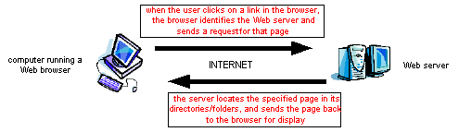
World Wide Web
the Web is the world’s largest client/server system
communication occurs via message passing
within browser, select URL of desired page
browser requests page from server
server responds with message containing
type of page (HTML, gif, pdf, zip, …)
page contents
browser uses type info to correctly display page
if page contains other items (images, applets, …),
browser must request each separately

Slide 10
HTTP vs HTML
HTML: hypertext markup language
Definitions of tags that are added to Web documents to control their appearance
HTTP: hypertext transfer protocol
The rules governing the conversation between a Web client and a Web server
Both were invented at the same time by the same person
The HTTP protocol used for Web applications was invented by Tim Berners Lee
Notes:
Both were invented at the same time by the same person

Slide 11
HTTP
Hypertext Transfer Protocol (HTTP):
application-level protocol for distributed, collaborative, hypermedia information systems
generic, stateless, object-oriented
can be used for many tasks, such as name servers & distributed object management systems
underlying language of the Web
HTTP/1.0 allowed only connectionless message passing
each request/response required a new connection
to download a page with images required multiple connections
can overload the server, require lots of overhead
HTTP/1.1 provides persistent connection by default
once client & server connect, remains open until told to close it (or timeout)
reduces number of connections, saves overhead
client can send multiple requests without waiting for responses
e.g., can request all images in a page at once

Slide 12
An HTTP conversation
Client
Server
OK
Send page or error message
OK
I would like to open a connection
GET <file location>
Display response
Close connection
HTTP is the set of rules governing the format and content of the conversation between a Web client and server

Slide 13
An HTTP example
The message requesting a Web page must begin with the work “GET” and be followed by a space and the location of a file on the server, like this:
GET /fac/lpress/shortbio.htm
The protocol spells out the exact message format, so any Web client can retrieve pages from any Web server.

Slide 14
Network protocols
The details are only important to developers.
The rules are defined by the inventor of the protocol – may be a group or a single person.
The rules must be precise and complete so programmers can write programs that work with other programs.
The rules are often published as an RFC along with running client and server programs.
The HTTP protocol used for Web applications was invented by Tim Berners Lee.
RFC = request for comments

Slide 15
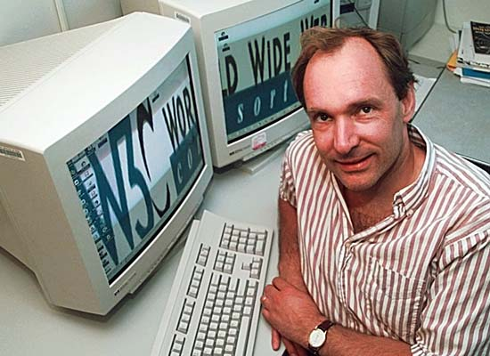
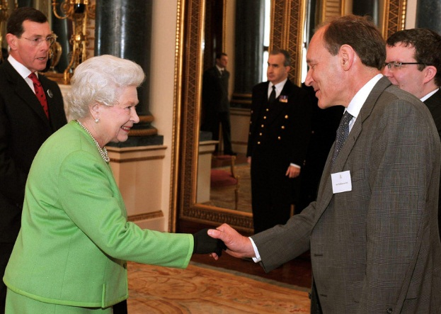
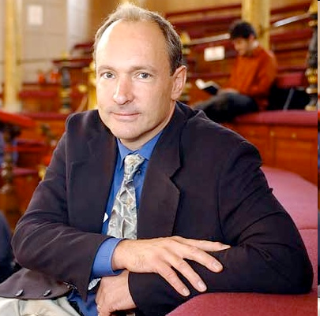
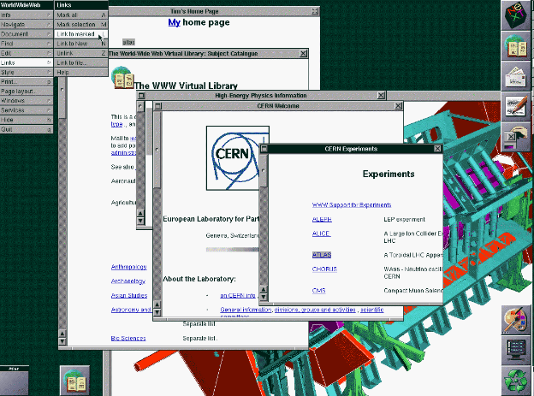
Tim Berners-Lee
Tim Berners-Lee was knighted by Queen Elizabeth for his invention of the World Wide Web. He is shown here, along with the first picture posted on the Web and a screen shot from an early version of his Web browser.
Notes:
Knighted: a man given a ran of honour

Slide 16
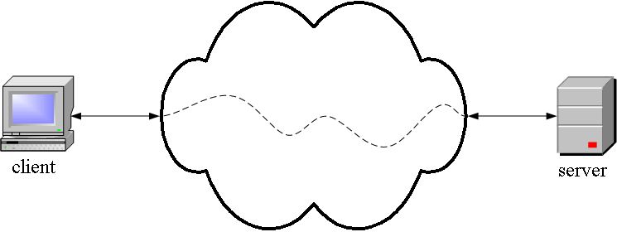
HTTP is an application layer protocol
The Web client and the Web server are application programs
Application layer programs do useful work like retrieving Web pages, sending and receiving email or transferring files
Lower layers take care of the communication details
The client and server send messages and data without knowing anything about the communication network

Slide 17
Many application layer protocols are used on the Internet, HTTP is only one
Protocol | Application
HTTP: Hypertext Transfer | Retrieve and view Web pages
FTP: File Transfer | Copy files from client to server or from server to client
SMTP: Simple Mail Transfer Protocol | Send email
POP: Post Office Protocol | Read email

Slide 18
The TCP/IP protocol layers
The application program is king – it gets work done using the lower level layers for communication between the client and server.
Application
Transport
Internet
Data link
Physical
Get useful work done – retrieve Web pages, copy files, send and receive email, etc.
Make client-server connections and optionally control transmission speed, check for errors, etc.
Route packets between networks
Route data packets within the local area network
Specify what medium connects two nodes, how binary ones and zeros are differentiated, etc,

Slide 19
Caching
browsers temporarily store pages or content of pages for future use
maintain temporary storage (cache) for recent pages
when a page is requested, check to see if already in cache
if not in the cache, issue GET request
when response message arrives,
display page and store in cache (along with header info)
if already stored in the cache, send GET request with If-Modified-Since header set to the data of the cached page
when response message arrives,
if status code 200, then display and store in cache
if status code 304, then display cached version instead

Slide 20
Cookies
HTTP message passing may be transaction-based,
many e-commerce apps require persistent memory of customer interactions
e.g., amazon.com
remembers your name, credit card, past purchases, interests
Netscape’s solution: cookies
a cookie is a collection of information about the user
server can download a cookie to the client’s machine using the “Set-cookie” header in a response
Set-cookie: CUSTOMER=Dave_Reed; PATH=/; EXPIRES=Thursday, 29-Jan-04 12:00:00
when user returns to URL on the specified path, the browser returns the cookie data as part of its request
Cookie: CUSTOMER=Dave_Reed

Slide 21
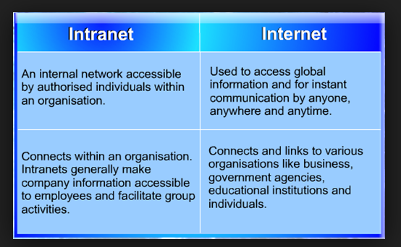

Slide 22
